Slide 1

Object Oriented Programming
AWT (Abstract Windowing Toolkit) and SWING

Slide 2
Introduction
Java AWT (Abstract Windowing Toolkit) is an API to develop GUI or window-based application in java.
Java AWT components are platform-dependent i.e. components are displayed according to the view of operating system.
AWT is heavyweight i.e. its components uses the resources of system.
The java.awt package provides classes for AWT API such as TextField, Label, TextArea, RadioButton, CheckBox, Choice, List etc.

Slide 3
AWT (Abstract Windowing Toolkit)
The AWT is roughly broken into three categories
Components
Layout Managers
Graphics
Many AWT components have been replaced by Swing components
It is generally not considered a good idea to mix Swing components and AWT components. Choose to use one or the other.

Slide 4
AWT Class Hierarchy
Component
Container
Window
Frame
Button
Panel
List
Checkbox
Choice
Note: There are more classes, however,
these are what are covered in this chapter
Label
TextComponent
TextField
TextArea
Notes:
This slide shows the hierarchy of classes which will be covered in this chapter. If you check the Java API documentation, you will note that there are many more classes in the java.awt package.

Slide 5
Using AWT in Java
To create simple AWT example, you need a frame. There are two ways to create a GUI using Frame in AWT.
By extending Frame class (inheritance)
By creating the object of Frame class (association)

Slide 6
Component
Component is the superclass of most of the displayable classes defined within the AWT. Note: it is abstract.
MenuComponent is another class which is similar to Component except it is the superclass for all GUI items which can be displayed within a drop-down menu.
The Component class defines data and methods which are relevant to all Components
setBounds
setSize
setLocation
setFont
setEnabled
setVisible
setForeground -- colour
setBackground -- colour
Notes:
The Component class contains the common features to all items which can be displayed in a GUI. Often, these items are called widgets. In the AWT, all widgets are components and, as such, inherit all the data and methods of the Component class.

Slide 7
Methods of Component class
Method | Description
public void add(Component c) | inserts a component on this component.
public void setSize(int width, int height) | sets the size (width and height) of the component.
public void setLayout(LayoutManager m) | defines the layout manager for the component.
public void setVisible(boolean status) | changes the visibility of the component, by default false.
void remove(Component c) | Remove a component
void setBounds(int x,int y, int width, int height) | Set the location and size of single component and useful only with null layout.

Slide 8
Container
Container is a subclass of Component. (ie. All containers are themselves, Components)
Containers contain components
For a component to be placed on the screen, it must be placed within a Container
The Container class defined all the data and methods necessary for managing groups of Components
add
getComponent
getMaximumSize
getMinimumSize
getPreferredSize
remove
removeAll
Notes:
The Container class is an abstract class which encapsulates the logic for managing Components. Note that Containers are, themselves, Components which means that Containers can be placed within other Containers

Slide 9
Container
Types of containers:
There are four types of containers in Java AWT:
Window : The window is the container that have no borders and menu bars. You must use frame, dialog or another window for creating a window. We need to create an instance of Window class to create this container.
Panel : The Panel is the container that doesn't contain title bar, border or menu bar. It is generic container for holding the components. It can have other components like button, text field etc. An instance of Panel class creates a container, in which we can add components.
Frame : The Frame is the container that contain title bar and border and can have menu bars. It can have other components like button, text field, scrollbar etc. Frame is most widely used container while developing an AWT application.
Dialog : The dialog is the container which is used for showing some messages or user related informations.
Notes:
The Container class is an abstract class which encapsulates the logic for managing Components. Note that Containers are, themselves, Components which means that Containers can be placed within other Containers

Slide 10
Windows and Frames
The Window class defines a top-level Window with no Borders or Menu bar.
Usually used for application splash screens
Frame defines a top-level Window with Borders and a Menu Bar
Frames are more commonly used than Windows
Once defined, a Frame is a Container which can contain Components
Frame aFrame = new Frame(Hello World);
aFrame.setSize(100,100);
aFrame.setLocation(10,10);
aFrame.setVisible(true);
Notes:
Generally speaking, the Window class is not used very often. The Frame class, on the other hand, is used quite extensively for GUI based applications.
Another subclass of Window, which is not described here, I the Dialog class. It is used to display Dialog Boxes. Dialog Boxes are generally used to convey important information to the user, and must be dismissed by the user before the application can continue. It should be noted that dialog boxes disrupt the flow of an application and can cause great user frustration if not used appropriately.

Slide 11
Panels
When writing a GUI application, the GUI portion can become quite complex.
To manage the complexity, GUIs are broken down into groups of components. Each group generally provides a unit of functionality.
A Panel is a rectangular Container whose sole purpose is to hold and manage components within a GUI.
Panel aPanel = new Panel();
aPanel.add(new Button("Ok"));
aPanel.add(new Button("Cancel"));
Frame aFrame = new Frame("Button Test");
aFrame.setSize(100,100);
aFrame.setLocation(10,10);
aFrame.add(aPanel);
Notes:
The Panel class is probably the most important class within the AWT. Panels can contain Components (which includes other Panels). It allows the GUI screen to be partitioned into manageable pieces. Panels should contain Components which are functionally related. For example, if an application wished to allow the user to input their name, address, phone number and other relevant contact information, it would be good design to place all of the necessary GUI Components on a Panel. That panel can be then added to and removed from other Containers within the application.

Slide 12
Buttons
This class represents a push-button which displays some specified text.
When a button is pressed, it notifies its Listeners. (More about Listeners in the next chapter).
To be a Listener for a button, an object must implement the ActionListener Interface.
Panel aPanel = new Panel();
Button okButton = new Button("Ok");
Button cancelButton = new Button("Cancel");
aPanel.add(okButton));
aPanel.add(cancelButton));
okButton.addActionListener(controller2);
cancelButton.addActionListener(controller1);
Notes:
All GUI systems offer some form of push button. The Button class in Java represents that functionality. Buttons are typically single purpose (ie. Their function does not change).

Slide 13
Labels
This class is a Component which displays a single line of text.
Labels are read-only. That is, the user cannot click on a label to edit the text it displays.
Text can be aligned within the label
Label aLabel = new Label("Enter password:");
aLabel.setAlignment(Label.RIGHT);
aPanel.add(aLabel);
Notes:
Many GUI applications require users to input data within TextFields, TextAreas, dropdown boxes, etc. However, presenting the user with an series of TextFields without any description would provide a great deal of confusion to the user. All GUI systems allow for the addition of Labels to the interface which provide textual information which aids in the description of the interface itself.

Slide 14
List
This class is a Component which displays a list of Strings.
The list is scrollable, if necessary.
Sometimes called Listbox in other languages.
Lists can be set up to allow single or multiple selections.
The list will return an array indicating which Strings are selected
List aList = new List();
aList.add("Calgary");
aList.add("Edmonton");
aList.add("Regina");
aList.add("Vancouver");
aList.setMultipleMode(true);
Notes:
The List class comes under many names in different GUI systems. Lists provide a list of strings (which is scrollable space the strings take up exceeds the allotted screen real estate) which can be selected by the user. The programmer may allow the user to select multiple strings within the list.

Slide 15
Checkbox
This class represents a GUI checkbox with a textual label.
The Checkbox maintains a boolean state indicating whether it is checked or not.
If a Checkbox is added to a CheckBoxGroup, it will behave like a radio button.
Checkbox creamCheckbox = new CheckBox("Cream");
Checkbox sugarCheckbox = new CheckBox("Sugar");
if (creamCheckbox.getState())
{
coffee.addCream();
}
Notes:
Checkboxes allow for yes/no selections by the user. Each checkbox maintains an internal state indicating whether it is selected or not. If it is selected, it will display itself in such a manner as to indicate it is selected. The state of a checkbox can be queried through the getState method.
Multiple checkboxes will all behave independently of one another meaning each one can be individually checked or unchecked. However, if a group of checkboxes are associated with a CheckBoxGroup object, then only one of the checkboxes can be selected at any one time. It is through the use of CheckBoxGroup that the AWT provides RadioButton functionality.

Slide 16
Choice
This class represents a dropdown list of Strings.
Similar to a list in terms of functionality, but displayed differently.
Only one item from the list can be selected at one time and the currently selected element is displayed.
Choice aChoice = new Choice();
aChoice.add("Calgary");
aChoice.add("Edmonton");
aChoice.add("Alert Bay");
String selectedDestination= aChoice.getSelectedItem();
Notes:
This class provides a list of strings to choose from (just like a list does) but the list is not displayed to the user at all times. Instead, the user must click the Choice to reveal the list. Once revealed, the user may select one of the items within the list. The currently selected item is displayed.

Slide 17
TextField
This class displays a single line of optionally editable text.
This class inherits several methods from TextComponent.
This is one of the most commonly used Components in the AWT
TextField emailTextField = new TextField();
TextField passwordTextField = new TextField();
passwordTextField.setEchoChar("*");
String userEmail = emailTextField.getText();
String userpassword = passwordTextField.getText();
Notes:
A TextField provides the user with a location that he/she may input a single line of text. Most TextFields are used in conjunction with a Label. The text provided by the label should describe the purpose (and thus, the expected input for) the TextField.

Slide 18
TextArea
This class displays multiple lines of optionally editable text.
This class inherits several methods from TextComponent.
TextArea also provides the methods: appendText(), insertText() and replaceText()
// 5 rows, 80 columns
TextArea fullAddressTextArea = new TextArea(5, 80);
String userFullAddress= fullAddressTextArea.getText();
Notes:
If the user is to input multiple lines of text, a TextArea is used instead of a TextField.

Slide 19
Layout Managers
Since the Component class defines the setSize() and setLocation() methods, all Components can be sized and positioned with those methods.
Problem: the parameters provided to those methods are defined in terms of pixels. Pixel sizes may be different (depending on the platform) so the use of those methods tends to produce GUIs which will not display properly on all platforms.
Solution: Layout Managers. Layout managers are assigned to Containers. When a Component is added to a Container, its Layout Manager is consulted in order to determine the size and placement of the Component.
NOTE: If you use a Layout Manager, you can no longer change the size and location of a Component through the setSize and setLocation methods.

Slide 20
Layout Managers (cont)
There are several different LayoutManagers, each of which sizes and positions its Components based on an algorithm:
FlowLayout
BorderLayout
GridLayout
For Windows and Frames, the default LayoutManager is BorderLayout. For Panels, the default LayoutManager is FlowLayout.

Slide 21
Flow Layout
The algorithm used by the FlowLayout is to lay out Components like words on a page: Left to right, top to bottom.
It fits as many Components into a given row before moving to the next row.
Panel aPanel = new Panel();
aPanel.add(new Button("Ok"));
aPanel.add(new Button("Add"));
aPanel.add(new Button("Delete"));
aPanel.add(new Button("Cancel"));
Notes:
Flow layout is the default layout manager for Panels

Slide 22
Border Layout
The BorderLayout Manager breaks the Container up into 5 regions (North, South, East, West, and Center).
When Components are added, their region is also specified:
Frame aFrame = new Frame();
aFrame.add("North", new Button("Ok"));
aFrame.add("South", new Button("Add"));
aFrame.add("East", new Button("Delete"));
aFrame.add("West", new Button("Cancel"));
aFrame.add("Center", new Button("Recalculate"));
Notes:
Border Layout is the default layout for Frames and Windows

Slide 23
Border Layout (cont)
The regions of the BorderLayout are defined as follows:
North
West
Center
East
South

Slide 24
Grid Layout
The GridLayout class divides the region into a grid of equally sized rows and columns.
Components are added left-to-right, top-to-bottom.
The number of rows and columns is specified in the constructor for the LayoutManager.
Panel aPanel = new Panel();
GridLayout theLayout = new GridLayout(2,2);
aPanel.setLayout(theLayout);
aPanel.add(new Button("Ok"));
aPanel.add(new Button("Add"));
aPanel.add(new Button("Delete"));
aPanel.add(new Button("Cancel"));

Slide 25
What if I don’t want a LayoutManager?
LayoutManagers have proved to be difficult and frustrating to deal with.
The LayoutManager can be removed from a Container by invoking its setLayout method with a null parameter.
Panel aPanel = new Panel();
aPanel.setLayout(null);
Ch. VIII - 25

Slide 26
Graphics
It is possible to draw lines and various shapes within a Panel under the AWT.
Each Component contains a Graphics object which defines a Graphics Context which can be obtained by a call to getGraphics().
Common methods used in Graphics include:
drawLine
drawOval
drawPolygon
drawPolyLine
drawRect
drawRoundRect
drawString
draw3DRect
fill3DRect
fillArc
fillOval
fillPolygon
fillRect
fillRoundRect
setColor
setFont
setPaintMode
drawImage

Slide 27
Event handling in Java
An event is when the state of an object changes. As an illustration, click a button or drag the mouse. Numerous event classes and Listener interfaces are available in the java.awt.event package for handling events.

Slide 28
Event handling in Java
The interfaces in charge of handling events are represented by event listeners.
Java has several event listener classes.
Each method of an event listener takes a single object parameter that is a subclass of the class EventObject.
For instance, methods that listen for mouse events will accept instances of MouseEvent, which is a descendant of EventObject.
Following is the declaration for java.util.EventListener interface:
public interface EventListener

Slide 29
Event Classes and Listener Interfaces
Event Classes | Listener Interfaces
ActionEvent | ActionListener
MouseEvent | MouseListener and MouseMotionListener
MouseWheelEvent | MouseWheelListener
KeyEvent | KeyListener
ItemEvent | ItemListener
TextEvent | TextListener
AdjustmentEvent | AdjustmentListener
WindowEvent | WindowListener
ComponentEvent | ComponentListener
ContainerEvent | ContainerListener
FocusEvent | FocusListener

Slide 30
How to do Event Handling in AWT
Register the component with the Listener
Implement the Listener in any of the three different ways:
Inside Class
Outside Class
Anonymous Class

Slide 31
How to do Event Handling in AWT
Button
public void addActionListener(ActionListener a){}
MenuItem
public void addActionListener(ActionListener a){}
TextField
public void addActionListener(ActionListener a){}
public void addTextListener(TextListener a){}
TextArea
public void addTextListener(TextListener a){}

Slide 32
How to do Event Handling in AWT
Checkbox
public void addItemListener(ItemListener a){}
Choice
public void addItemListener(ItemListener a){}
List
public void addActionListener(ActionListener a){}
public void addItemListener(ItemListener a){}

Slide 33
Java Swing
Java Swing is a part of Java Foundation Classes (JFC) that is used to create window-based applications. It is built on the top of AWT (Abstract Windowing Toolkit) API and entirely written in java.
Unlike AWT, Java Swing provides platform-independent and lightweight components.
The javax.swing package provides classes for java swing API such as JButton, JTextField, JTextArea, JRadioButton, JCheckbox, JMenu, JColorChooser etc.

Slide 34
What is JFC
The Java Foundation Classes (JFC) are a set of GUI components which simplify the development of desktop applications.

Slide 35
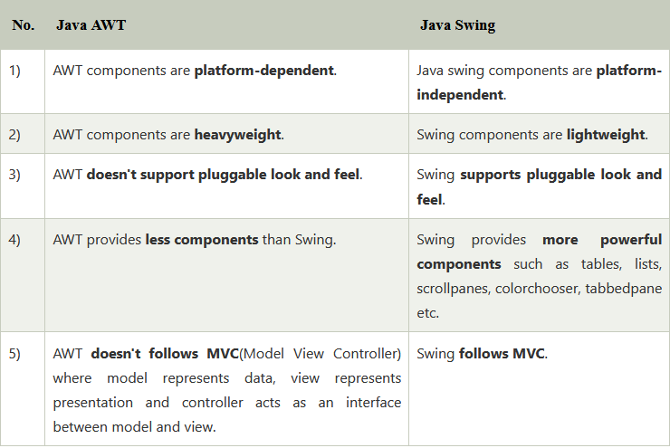
Difference between AWT and Swing

Slide 36
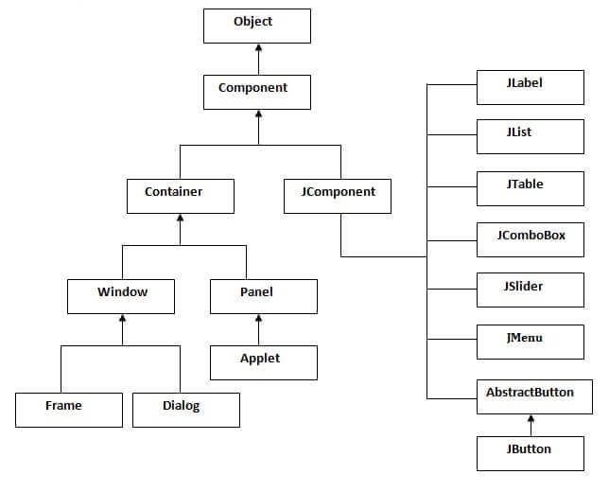
Hierarchy of Java Swing classes

Slide 37
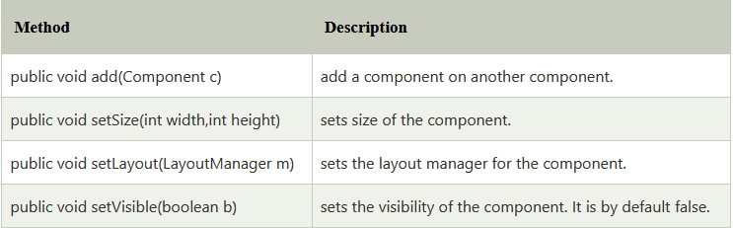
Commonly used Methods of Component class

Slide 38
Implementing Java Swing
There are two ways to create a frame:
By creating the object of Frame class (association)
By extending Frame class (inheritance)
We can write the code of swing inside the main(), constructor or any other method.

Slide 39
Java Layout Managers
The LayoutManagers are used to arrange components in a particular manner. The Java LayoutManagers facilitates us to control the positioning and size of the components in GUI forms. LayoutManager is an interface that is implemented by all the classes of layout managers. There are the following classes that represent the layout managers:

Slide 40
Java Layout Managers
java.awt.BorderLayout
java.awt.FlowLayout
java.awt.GridLayout
java.awt.CardLayout
java.awt.GridBagLayout
javax.swing.BoxLayout
javax.swing.GroupLayout
javax.swing.ScrollPaneLayout
javax.swing.SpringLayout etc.

